Slide 1
DSAI PROJECT · MILESTONE 5
Prompt Compression for
Hindi Question Answering
Trained Model, Systematic Hyperparameter Optimization, and Final Evaluation of an XLM-RoBERTa Token-Classification Compressor
0.59
0.83
4
2,015
BEST VALIDATION F1
TEST ROC-AUC
HYPERPARAMETER EXPERIMENTS
SAMPLES USED

Slide 2
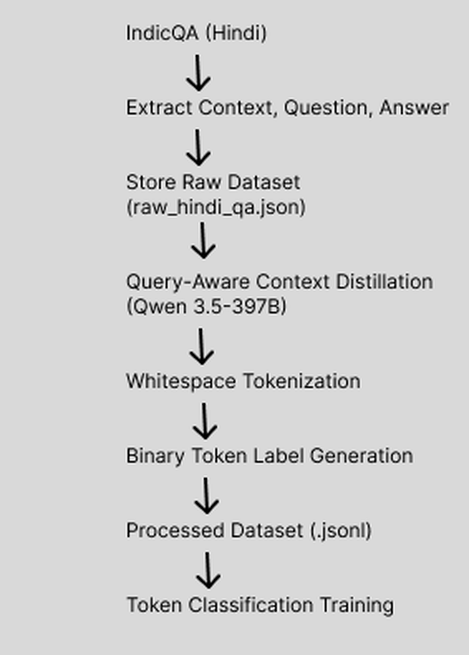
1
APPROACH
Compression as Token Classification
Rather than generating a compressed prompt directly, the task is framed as sequence labeling: every token is scored Keep or Remove.
1
Dataset
IndicQA (Hindi) question–context–answer triples form the raw input.
2
Distillation
A large model (Qwen 3.5-397B) performs query-aware context distillation to produce compressed reference prompts.
3
Label Alignment
Compressed prompts are aligned back to whitespace tokens, producing binary retain/discard labels.
4
Fine-Tuning
An XLM-RoBERTa token-classification head is fine-tuned on the labeled dataset to predict Keep vs. Remove for every subword token.
End-to-End Training Pipeline
01

Slide 3
2
EVALUATION SETUP
Data Splits, Preprocessing & Environment
1,610
202
203
RUNTIME ENVIRONMENT
GPU
train.jsonl
val.jsonl
test.jsonl
2 × NVIDIA Tesla T4 (15 GB each)
CUDA
Samples include question, original answer, whitespace tokens, and binary keep/discard labels.
13.0 · Driver 580.159.04
FRAMEWORKS
PREPROCESSING PIPELINE
PyTorch + Hugging Face Transformers
Tokenize with the XLM-RoBERTa tokenizer
DATA TOOLS
Align binary labels to generated subword tokens
HF Datasets, Evaluate, Scikit-learn
PRECISION
Assign ignore label (-100) to padding & continuation subwords
Mixed-precision (FP16) training
Apply dynamic padding via data collator for batching
REPRODUCIBILITY
Fixed random seed across runs
02

Slide 4
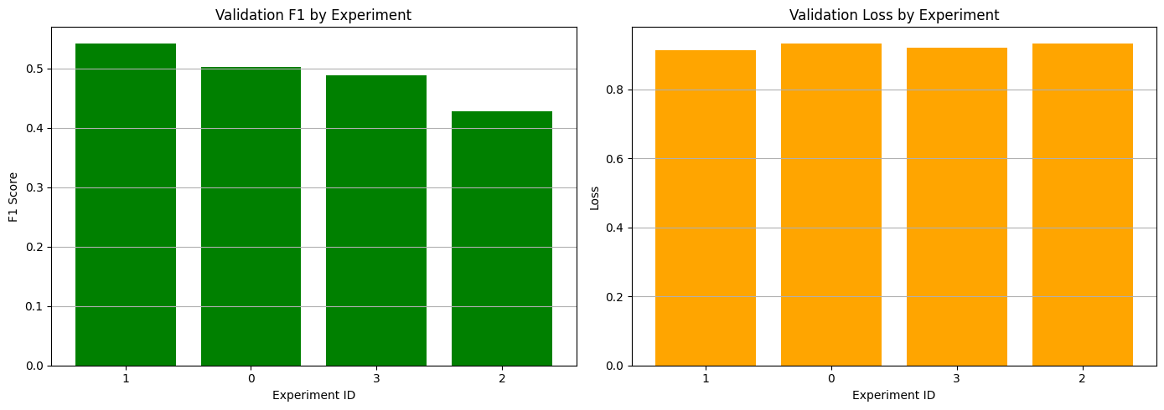
3
HYPERPARAMETER TUNING
Four Configurations, One Clear Winner
F1-score (balancing Precision & Recall) is the primary criterion — not accuracy — for this binary token-classification task.
Exp | LR | Batch | Wt Decay | Warmup | Acc | Prec | Recall | F1
0 | 1e-05 | 8 | 0.01 | 100 | 0.73 | 0.54 | 0.46 | 0.50
1 | 2e-05 | 8 | 0.01 | 100 | 0.74 | 0.55 | 0.53 | 0.54
2 | 3e-05 | 16 | 0.01 | 200 | 0.72 | 0.51 | 0.36 | 0.42
3 | 2e-05 | 8 | 0.1 | 100 | 0.74 | 0.57 | 0.42 | 0.48
Validation F1 & loss by experiment
Experiment 1 (lr = 2e-05, batch = 8) achieved the best Validation F1 (0.54) with a low, stable validation loss.
WHY EXPERIMENT 2 UNDERPERFORMS
Lower loss did not always mean better F1 — Experiments 0 and 3 had similar losses to Experiment 1 but noticeably lower F1-scores.
A larger batch size (16), higher learning rate (3e-05), and longer warmup (200 steps) combine to give the lowest Recall (0.36) and F1 (0.42) of all four runs — despite a validation loss similar to the top performers.
This selected setup — lr 2e-05, batch 8, weight decay 0.01, warmup 100 — was carried forward and trained for 20 epochs to build the final model (next slide).
03

Slide 5
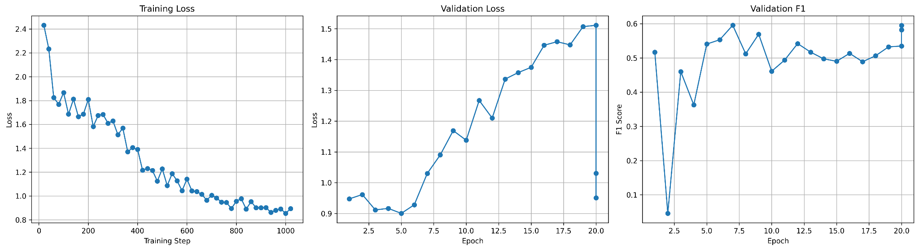
4
FINAL TRAINING
Training the Selected Configuration to Convergence
BEST CONFIGURATION
Learning Rate
2e-05
Batch Size
8
Weight Decay
0.01
Warmup Steps
100
Epochs
20
Training loss steadily decreases over 20 epochs, while validation loss begins rising after ~epoch 10 — a sign of overfitting even as validation F1 remains in the 0.5–0.6 range.
BEST VALIDATION F1
0.59
Takeaway: extended training keeps improving token-level F1 despite rising loss — F1, not loss, should drive checkpoint selection here.
04

Slide 6
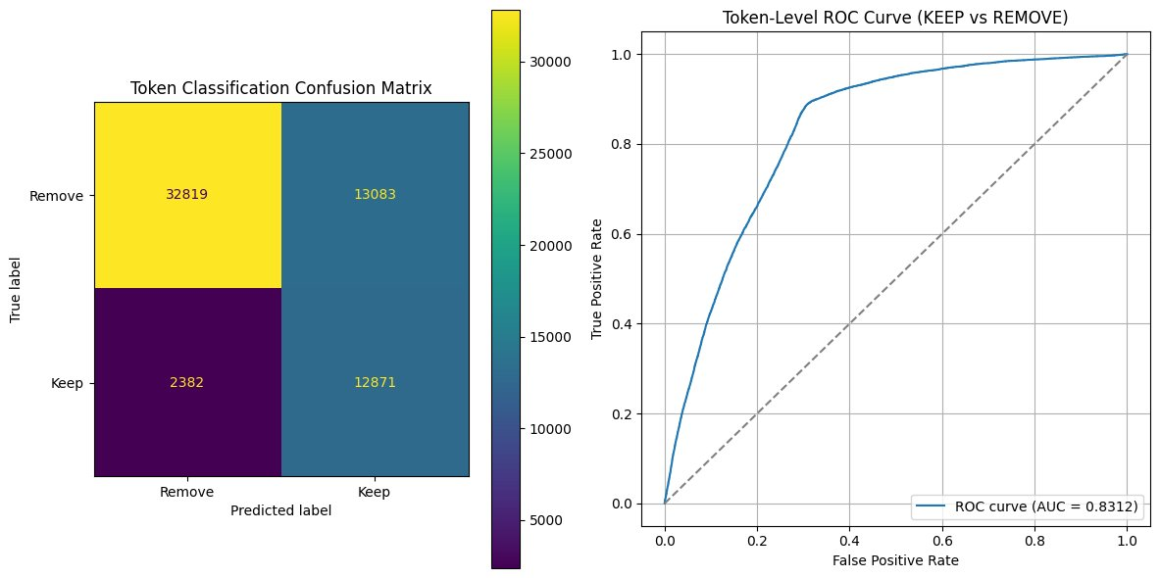
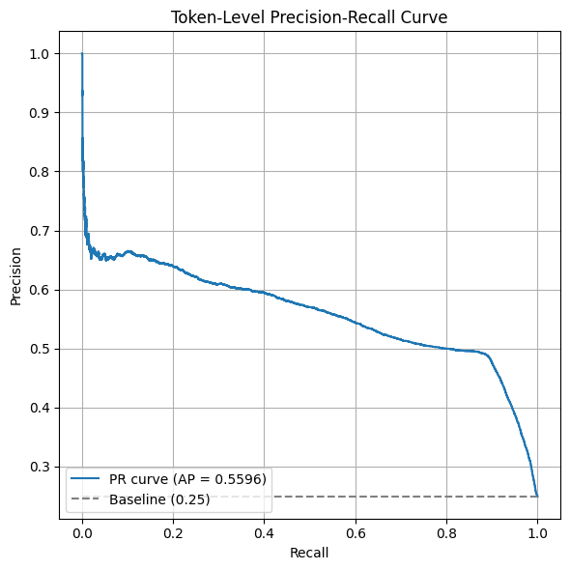
5
FINAL EVALUATION
Test-Set Performance & Discrimination
1.03
0.73
0.53
0.67
0.59
Loss
Accuracy
Precision
Recall
F1-score
Precision–Recall curve (AP ≈ 0.56) — the expected precision/recall trade-off as more tokens are retained.
Confusion matrix (32,819 Remove tokens correctly identified) and ROC curve (AUC = 0.83) show strong class discrimination.
05

Slide 7
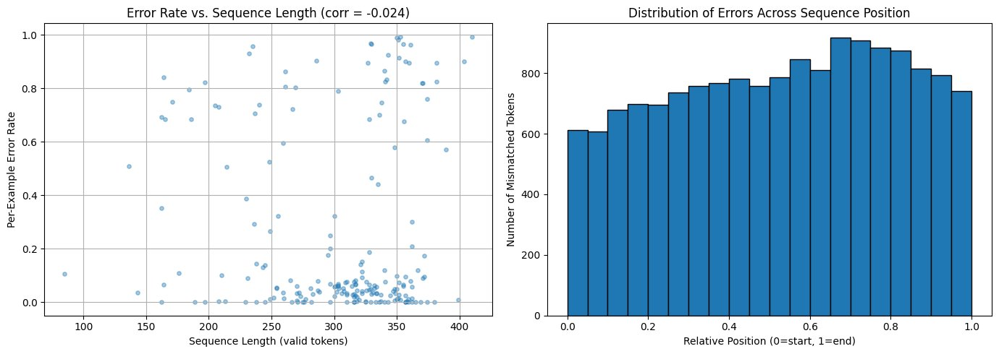
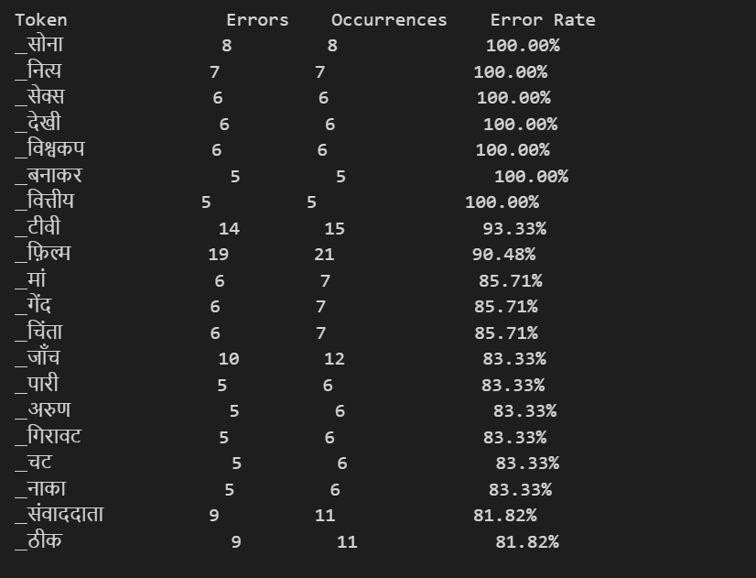
6
QUALITATIVE ANALYSIS & LIMITATIONS
Where the Model Still Struggles
KEY LIMITATIONS
A small set of low-frequency Hindi tokens (e.g. सोना, नित्य, वित्तीय) are misclassified 100% of the time.
Common words like टीवी (93%) and फ़िल्म (90%) also show persistently high error rates.
Errors cluster in a small token subset rather than spreading uniformly — a clear target for future data coverage.
Error rate is uncorrelated with sequence length (corr = -0.024), but errors concentrate in the latter 60–90% of a sequence's tokens.
Validation F1 (~0.53–0.59) trails the strong ROC-AUC (0.83), showing discrimination is good but precision/recall balance still has room to improve.
Highest-error tokens observed in the evaluation set
06

